Slide 1
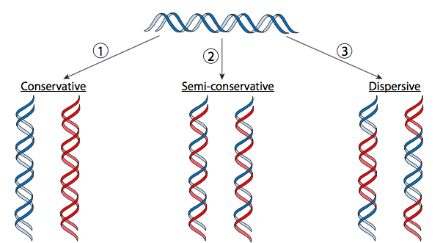
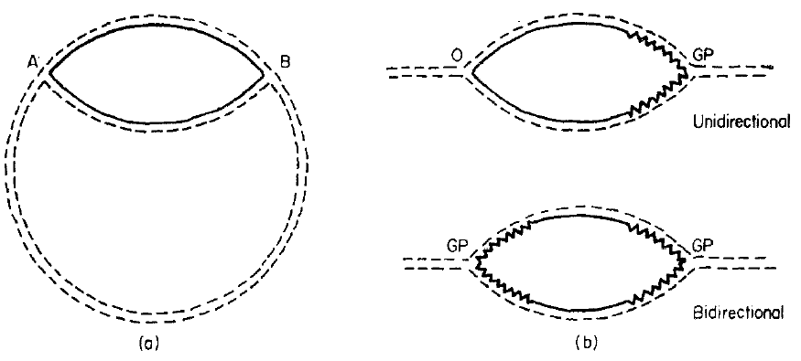
Lecture - 9
DNA replication is semi-conservative
DNA replication is bidirectional
Replication forks originate randomly?
Notes:
Can be tested by denaturation mapping

Slide 2
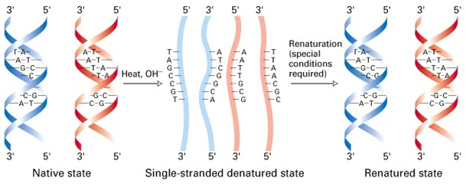
Denaturation and renaturation of DNA strands
T_{m} depends on GC content

Slide 3
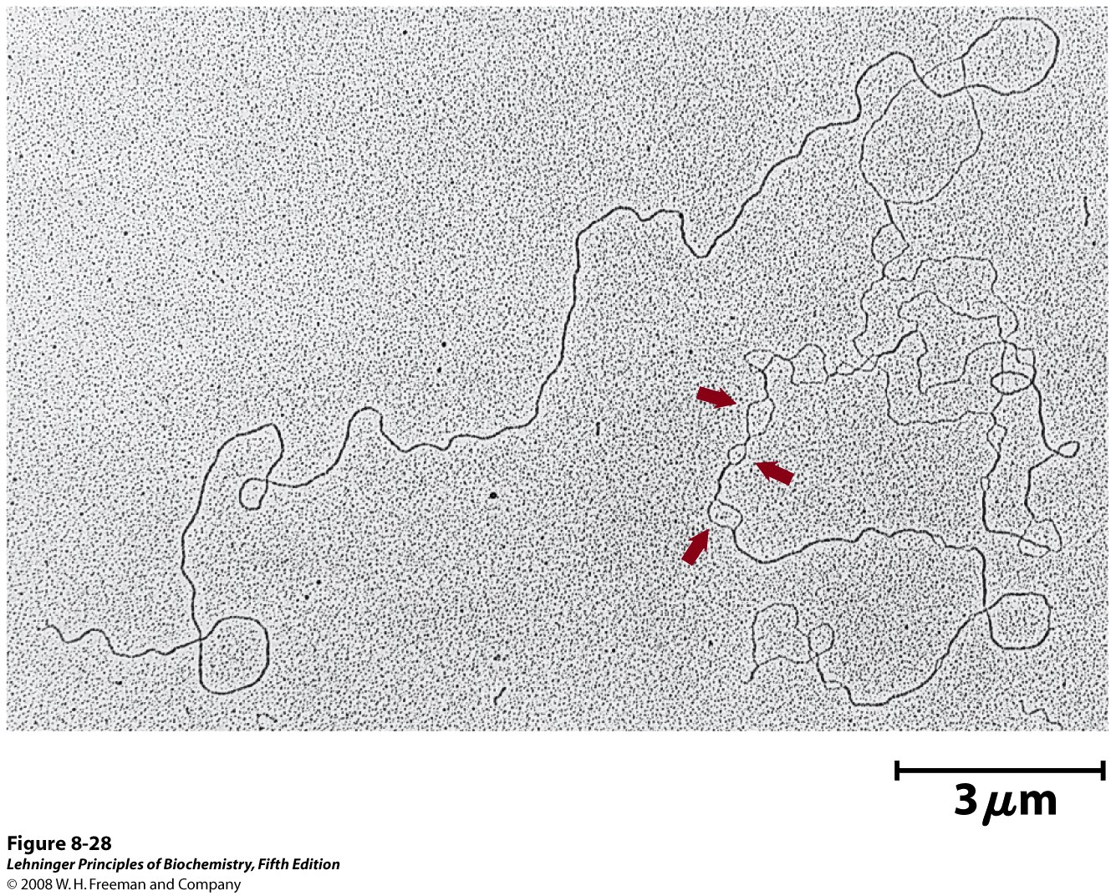
Partially denatured DNA
Origin of replication:
An origin of replication is a sequence of DNA at which replication is initiated on a chromosome, plasmid or virus. For small DNAs, including bacterial plasmids and small viruses, a single origin is sufficient. Larger DNAs have many origins, and DNA replication is initiated at all of them; otherwise, if all replication had to proceed from a single origin, it would take too long to replicate the entire DNA

Slide 4
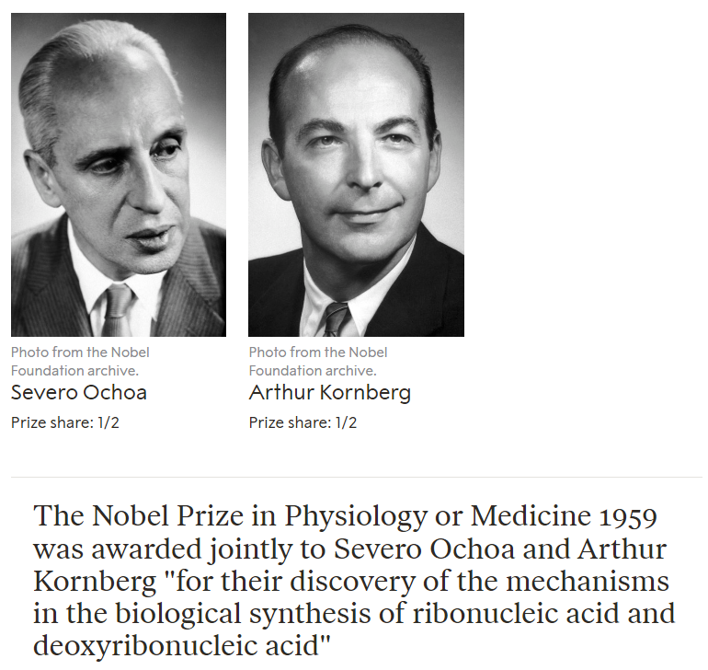

Slide 5
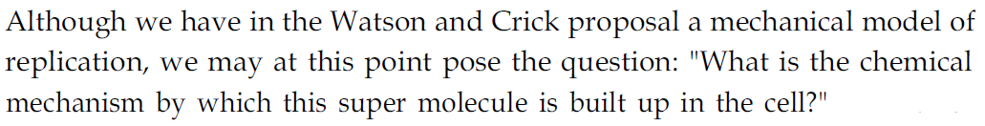
J Biol Chem. 1958 Jul;233(1):163-70
Notes:
The Nobel Prize in Physiology or Medicine 1962 was awarded jointly to Francis Harry Compton Crick, James Dewey Watson and Maurice Hugh Frederick Wilkins
Before Watson and crick Kornberg got the Nobel Prize
Griffith, Avery Mccleoid and McCerty Hershey Chase

Slide 6
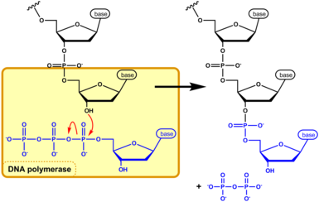
DNA Polymerase activity

Slide 7
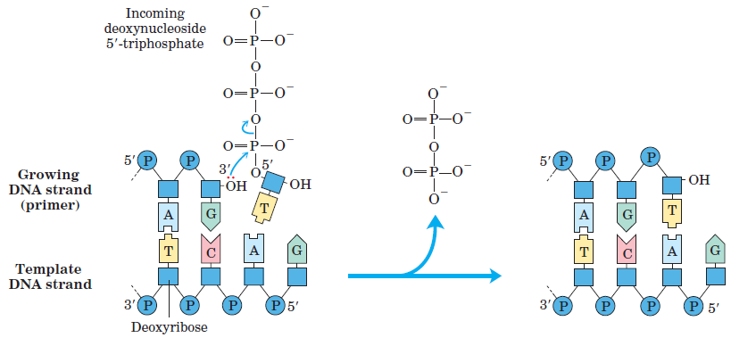
Correct pairing of base: A prerequisite for elongation

Slide 8
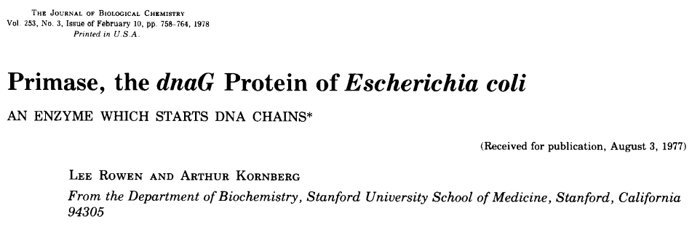
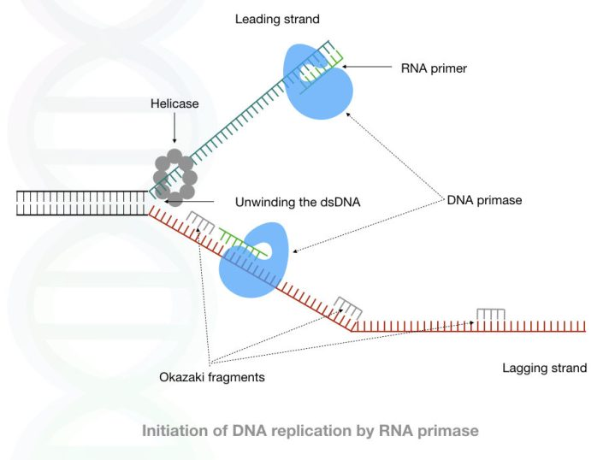

Slide 9
DNA Polymerase cannot accommodate rNTPs
Notes:
Changing these amino acids to other amino acids with smaller side chains (e.g., by changing a glutamate to an alanine) results in a DNA polymerase with significantly reduced discrimination between dNTPs and rNTPs.

Slide 10
5’
3’

